Slide 1
Population Characteristics
Identify factors that can influence a person’s ability to evacuate
Explain the impact of different population characteristics

Slide 2
Historic Fire
Arundel Park

Slide 3
Occupant Characteristics
Not all people are the same
  Designs based off of “expected” population
  Homogeneous?
  Not always obvious which occupants are most at risk
Number of people
  Occupant load factors?
  Crowded conditions more problematic
Locations of people

Slide 4

Factors
Alertness
  Sleep
  Drugs/alcohol/medication
Physical and cognitive ability
  Poor understanding
  Temporary condition
  Permanent condition
  Different impact of effluent
  Notification
  Movement

Slide 5

Factors
Social affiliation
  Seek out others
  Move at speed of slowest member
  Impact flow
Role and responsibility
  Staff
  Activities other than evacuation
Previous experience

Slide 6

Factors
Commitment
  Inattentional blindness/deafness
  Refusal to leave task
Focal point
  Inattentional blindness/deafness
  Beneficial use

Slide 7

Factors
Age
  Movement speeds
  Sensory skills
  Decision making
  Impact of effluent

Slide 8

Factors
Familiarity
External
  Weather
  Egress systems
  Light
  Noise

Slide 9

Personal Characteristics
Age
Gender
Pre-evacuation
Body size
Perception
Knowledge
Experience
Notification

Slide 10

Mobility
Disabilities
Encumbrances
Clothing
Fatigue
Groups

Slide 11
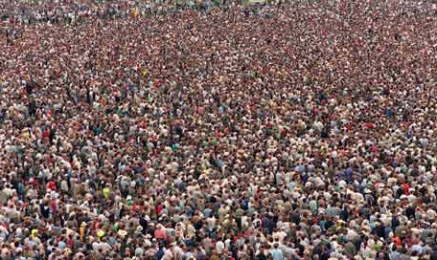
Position Factors
Density
Exit lanes

Slide 12
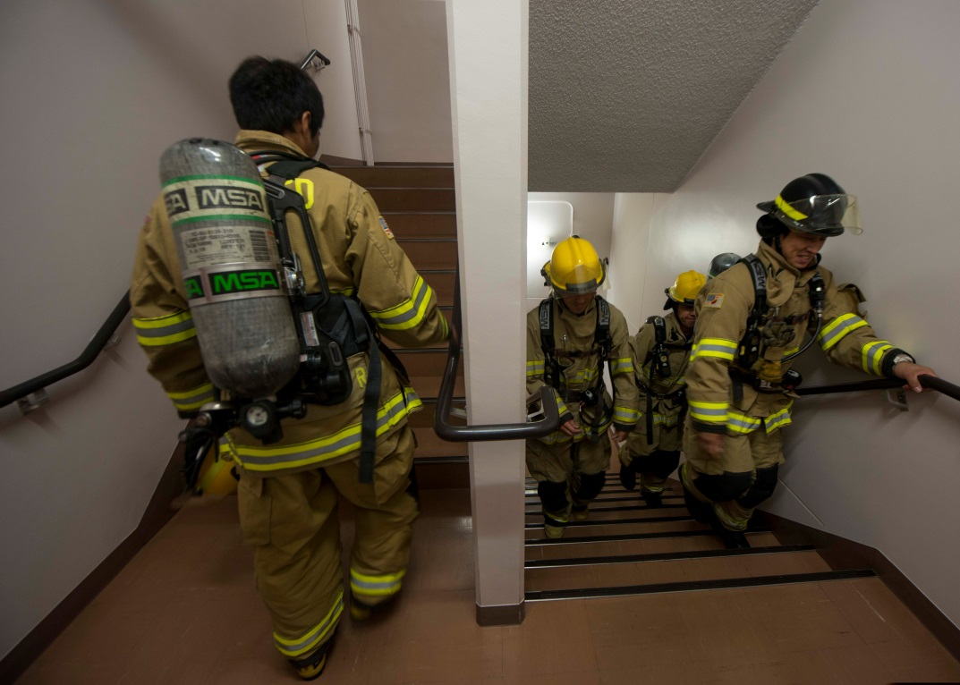
Interactions
Merging
Passing
Counterflow
Congestion

